Slide 1



GEOSS Common Infrastructure (GCI) for Earth Observation Networks
Workshop “Observing Europe: Networking the Earth Observation Networks in Europe”
Paris 21 ⁻ 22 Sep 2015
Stefano nativi
Institute of Atmospheric Pollution Research,
National Research Council of Italy

Slide 2
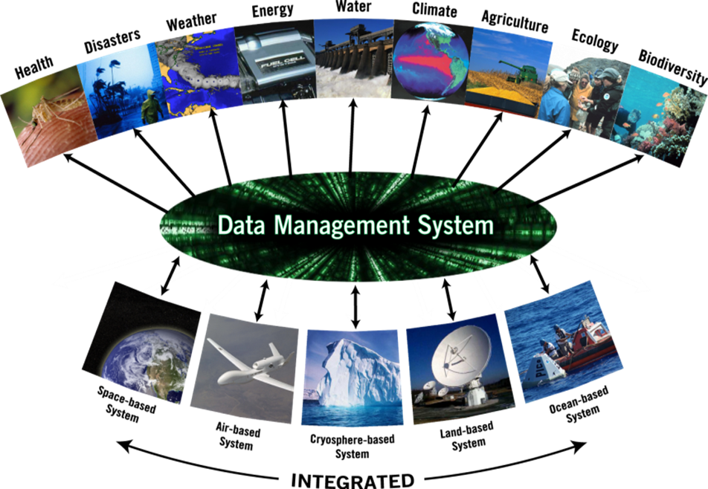

GEOSS Discovery and Access Infrastructure
Many possible User Targets
Discovery & Access
Infrastructure
Unified, Simplified, Flexible
Discovery and Access services interface
Vast
Supply System

Slide 3


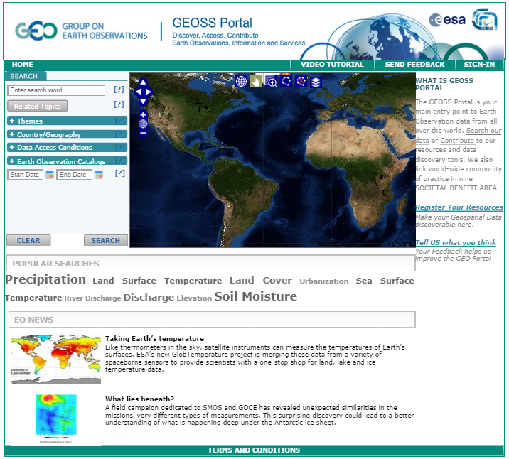

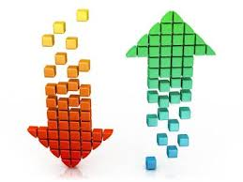
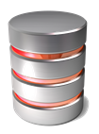

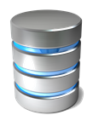

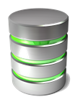


GEOSS Users
GEOSS Applications
GEOSS Applications
GEOSS Applications
GEOSS Applications
GEOSS Community Environment
GEOSS Application Developers
GEOSS Common Governance
GEOSS Common Infrast.
GEOSS metasystem
… .
System 1
System 3
System 4
System 1
System 2
System 2
System 3
System 2
… .
System 3
System 4
System 4
System z
System 1
Domain K
… .
… .
System j
System i
Domain A
Domain B
GEOSS
Providers

Slide 4


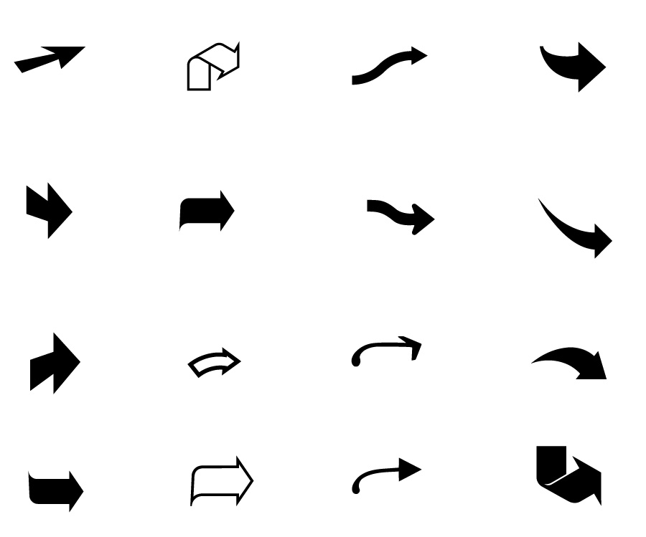



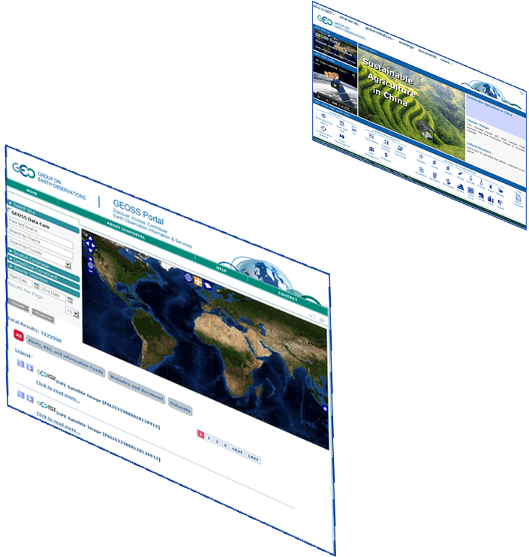





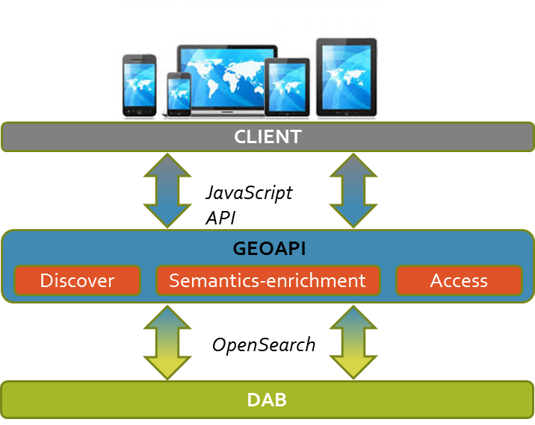




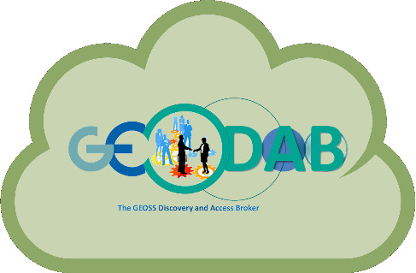









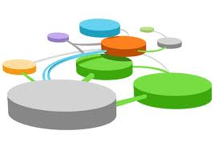













GEOSS Information System
GEO Home Page
GEOSS Apps
About 50
Supply Systems
GEOSS Portal
Brokering Framework
Registry (CSR)
Semantic engines
.. .
Data Providers Brokered (capacities, systems, networks, etc.)
.. .
Private sector(tested interoperability)

Slide 5
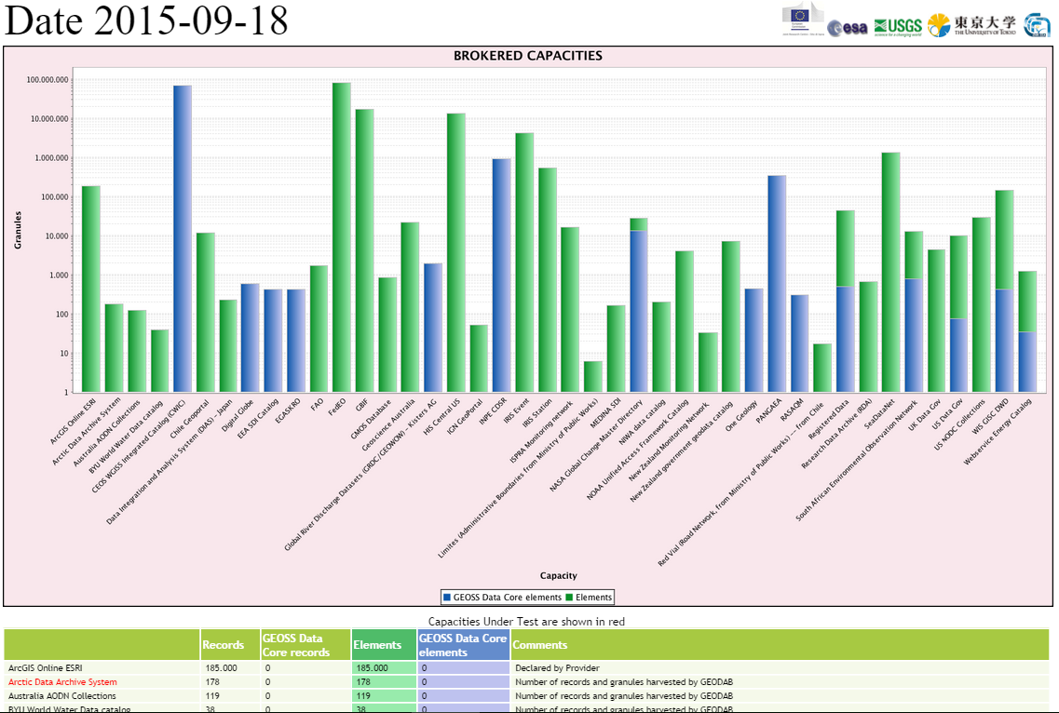
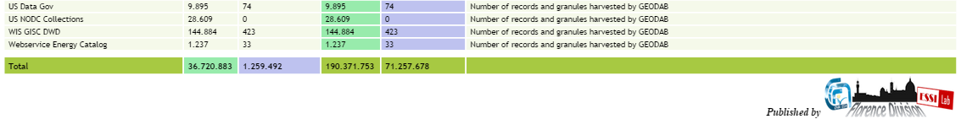
Ongoing Brokering tests:
IGN
DigitalGlobe
GBIF
Geoscience Australia
FP7 GeoCarbon DBs
UK.gov
FAO
RapidEye
EO MAP
Arctic Data archive System (ADS)





Slide 6
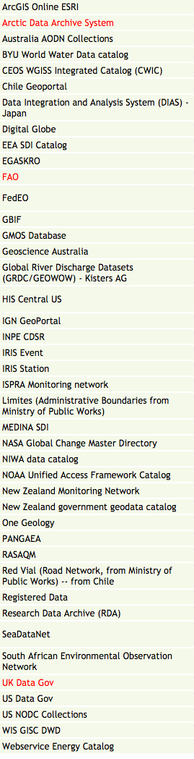
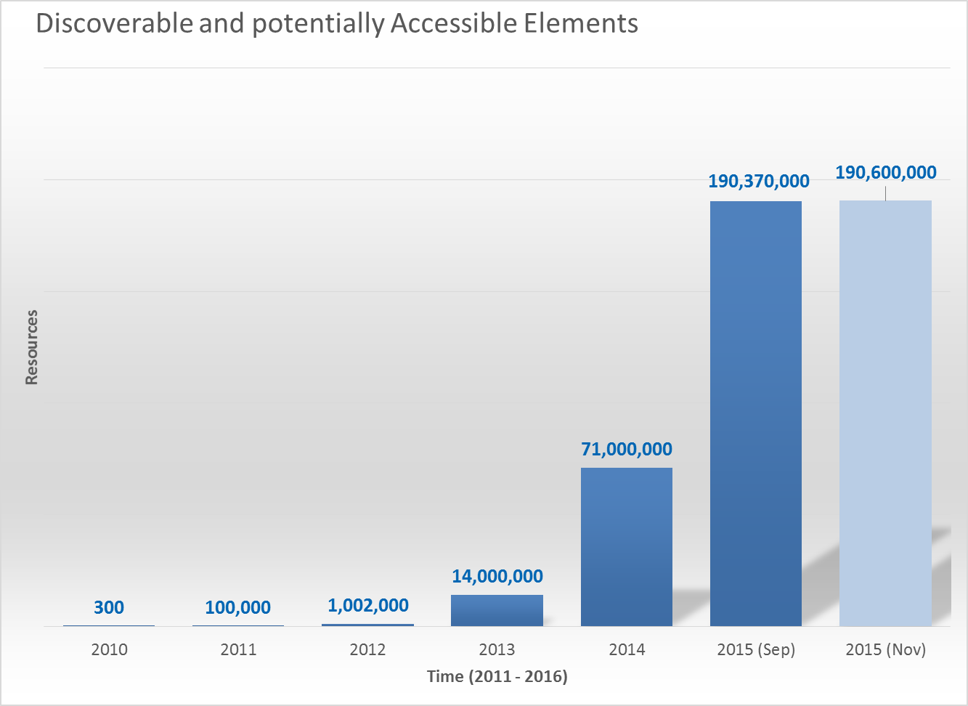
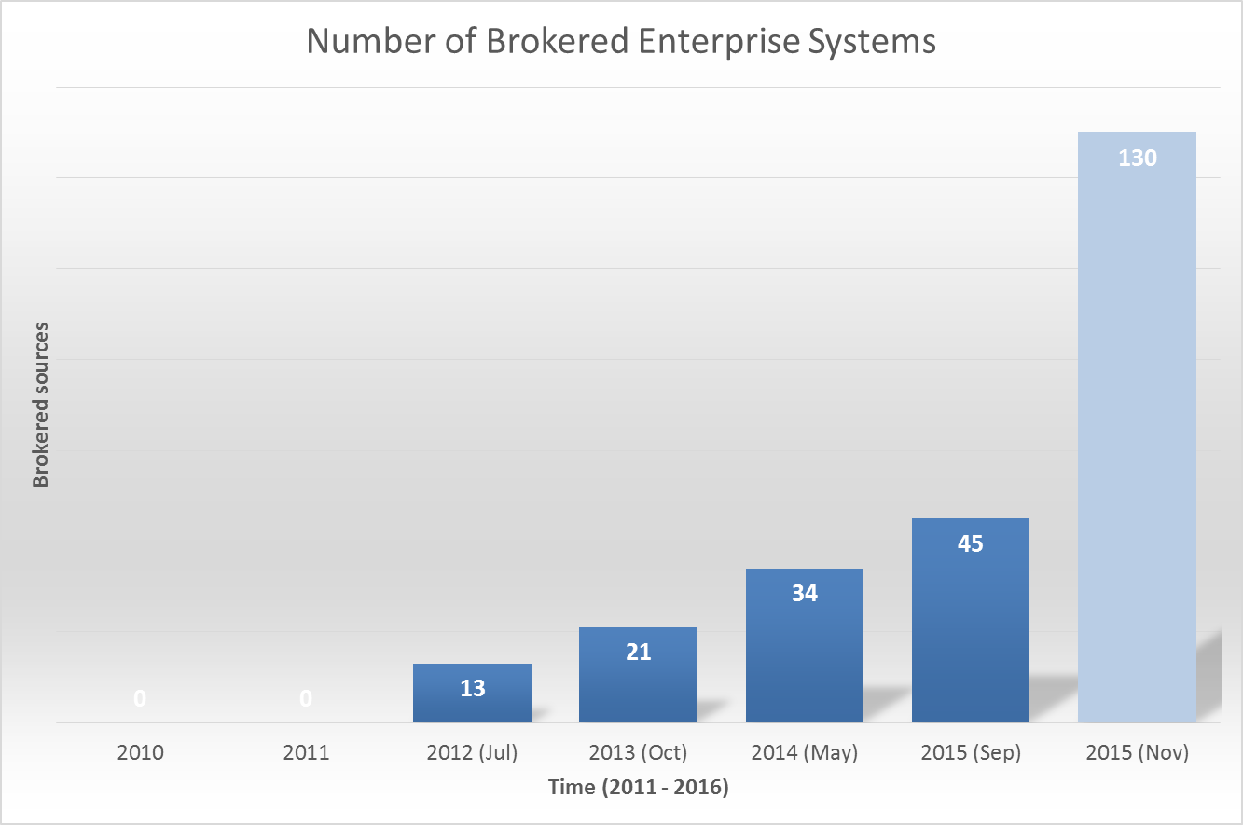
GCI Providers Evolution and statistics
Introduction of the Brokering approach
CSR brokering
Introduction of the Brokering approach

Slide 7
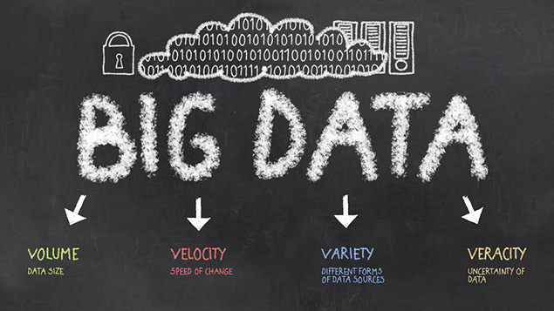
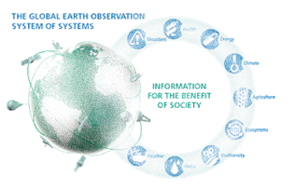


Big Data challenges for the GCI
  Volume: Millions of discoverable (small & medium) products; Long EO time/space series, … .
Variety: Different product types (data, services, models, documents); Data models; Protocols; Semantics; Granularity levels; Organizations; Maturity level, … .
Veracity/Validity/Value: Evaluation support, Essential Variables, Discovery Ranking, User Feedbacks, … .
Velocity: serve Countries with limited Internet access, Fast Discovery & Access, Data Transformation and Analytics
Visualization: Preview, Tiling services, visual exploration, … .
Cloud-based Software Ecosystem

Slide 8

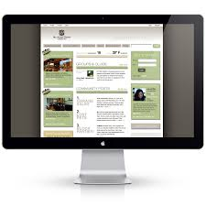


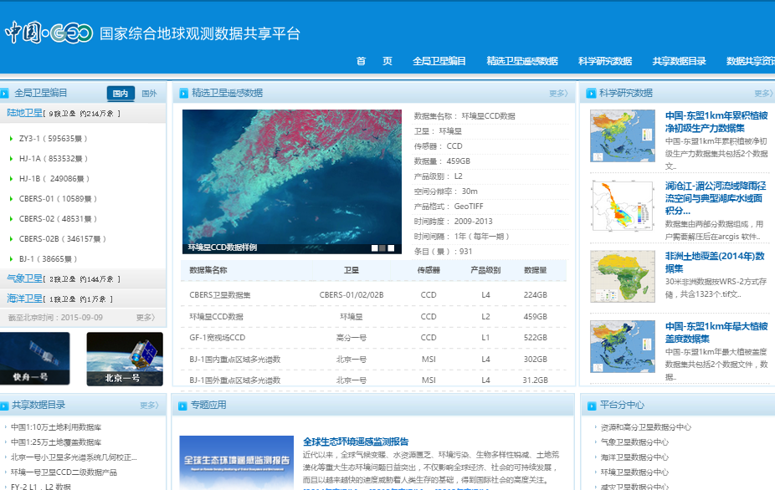

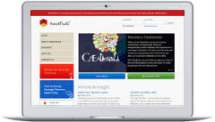




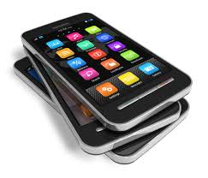


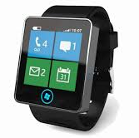






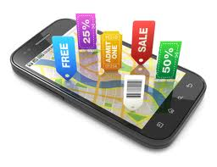










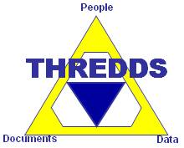
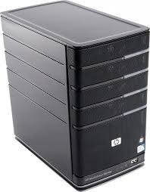






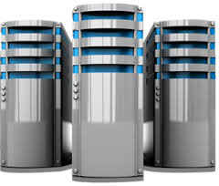
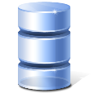






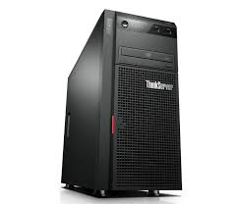

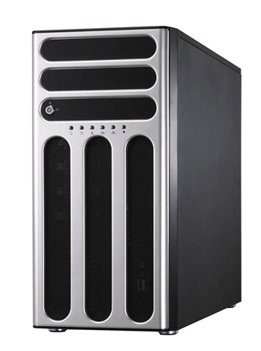


Applications, Mobile Apps, Community Portals, Clients
WIS
(KMA node)
CEOS
Water Portal
GEOSS App Developers
GEOSS Portal
ArcGIS
online
China-GEOSS Portal
APIs
Software
My-GEOSS
Discovery
Evaluation
Processing
(simple)
Access
Visualization
Brokering
Services
AIP-8 pilots
Tagging
Workflow mangmt
Mediation
Tiling
Monitoring
QoS control
Platform
.. and more ...
Infrastructure
Vast
Data Supply System

Slide 9
Cloud IaaS and PaaS
Computing
Monitoring
Auto Scaling
Routing
Storage
NoSQL Database Clustering
Load Balancing

Slide 10
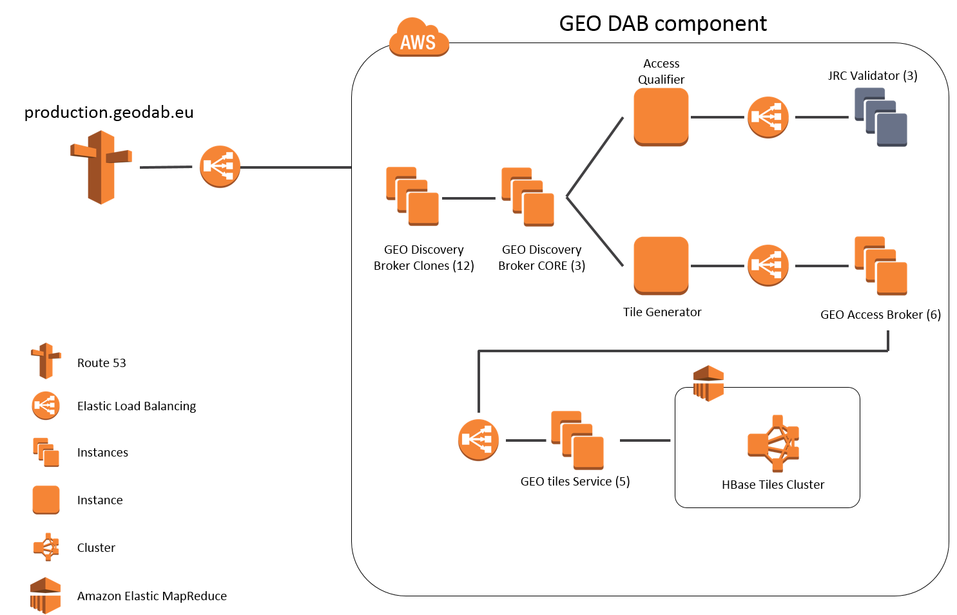
GEO DAB in the Cloud
Scalable and reliable platform
More than 30 (autoscaling)
virtual machines
on a public cloud
15 GEO Discovery Broker nodes
6 GEO Access Broker nodes
3 Data Provider Service Validator nodes
4 Elastic Load Balancing nodes
5 GEO Tiles nodes
1 Hbase Tiles (elastic) Cluster

Slide 11
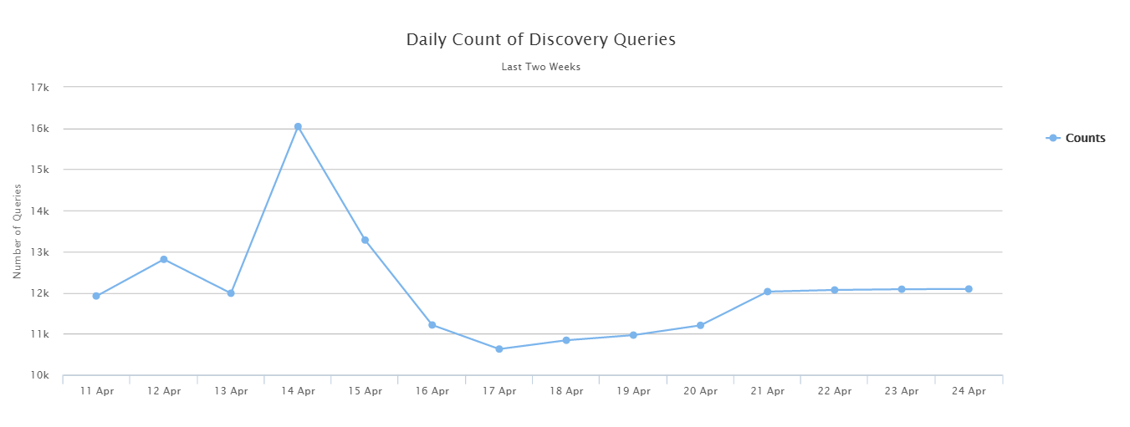
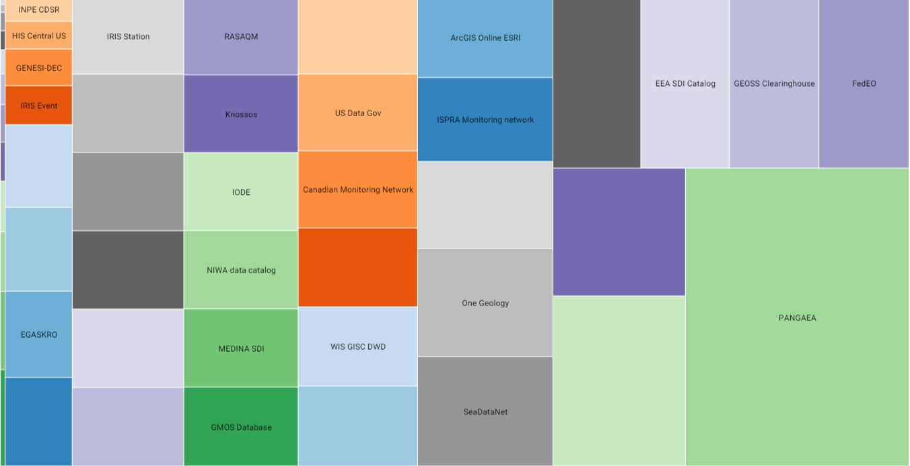
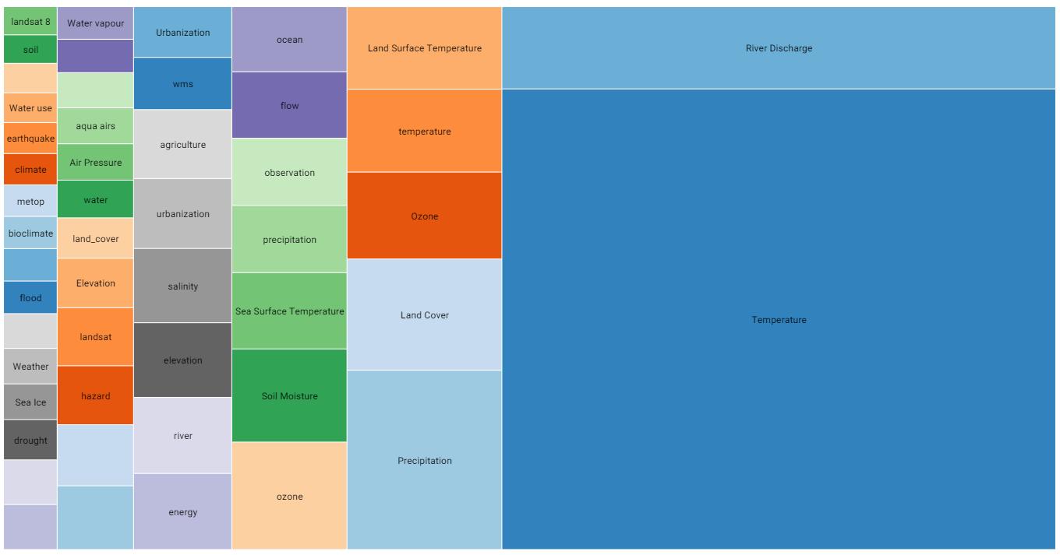
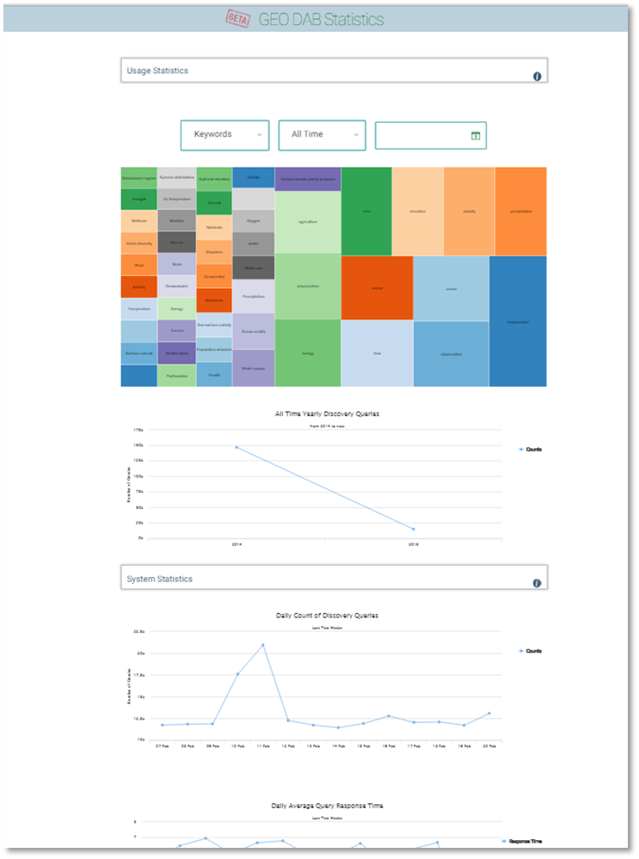
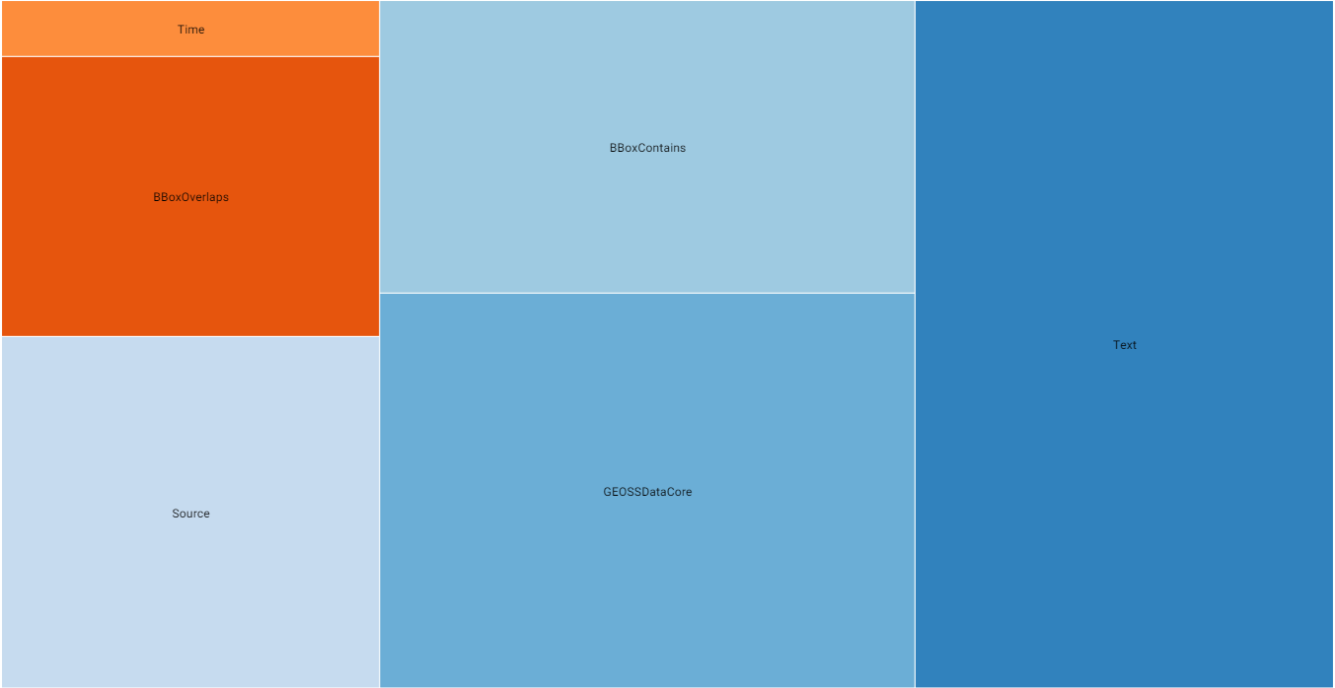
GCI (GEO DAB) Usage Statistics
Monitor and assess the GCI/GEO DAB Usage*
2014: more than 410 thousands
First 4 months 2015: more than 150 thousands
Last two weeks: around 12 thousand per day
* Only User’s requests contribute to the statistics
All Time
Yearly
Monthly
Daily
PANGAEA
GRDC GEOWOW
CEOS WGISS
FedEO
EEA SDI
…. .
Number of Discovery Queries finalized
Most Searched Keywords
Most Searched Data Sources
Most Used Query Constraints:
Simple constraint
Complex constraint
Temperature
River Discharge
Precipitation
Land Cover
…. .
Keyword
GEOSS Data-CORE
BBOX
… .
http://statistics.geodab.eu/gi-stat/stats

Slide 12






GCI APIs
High level open APIs to develop GEOSS applications
APIs = Application Program Interfaces
Applications
Developers
APIs
JavaScript APIs for GEOSS resources
Discovery
Semantic enriched discovery
Access
Visualization
GCI
http://api.eurogeoss-broker.eu/docs/index.html

Slide 13











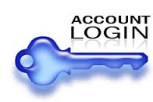







Authentication
Support existing and well-used users’ credentials (e.g. Google, Twitter, etc.)
GCI
Authentication service

Slide 14
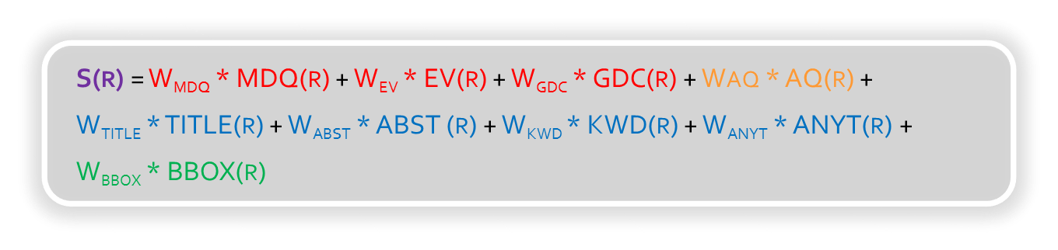
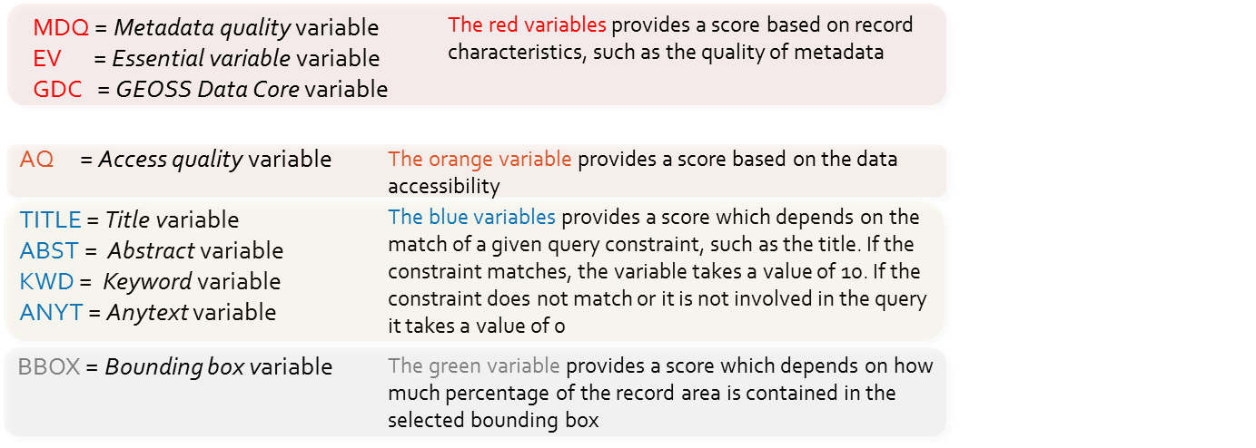
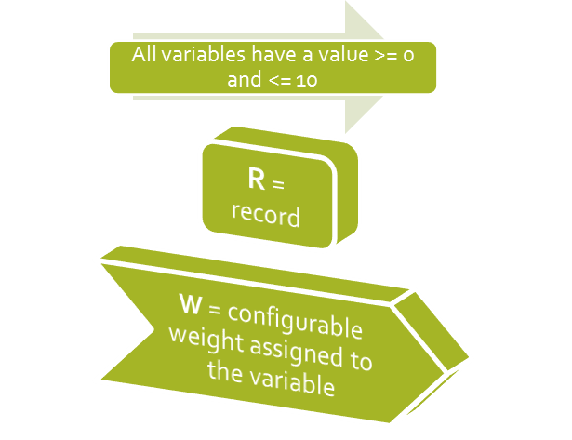
Ranking and paging
Configurable and flexible

Slide 15


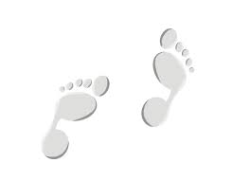
Search refinement
To refine search
◆ Query
❖ Results filtering
Filter matching results by:
  Sources
  Keywords
  Bbox
  Service type/Data format
Two-steps query
  Time series discovery
  Time slots selection
❖ Time slot
◆ Time series

Slide 16












Quality check
Read CSR Metadata Records
Test Link Reachability
Content Classification
Test Accessibility
Harvest Metadata
Update
GCI
Configuration
Q1
Q2
Q3
Q4
Knowledge
Base
Data Base
GEOSS CSR

Slide 17

The next future
Personal Vision

Slide 18
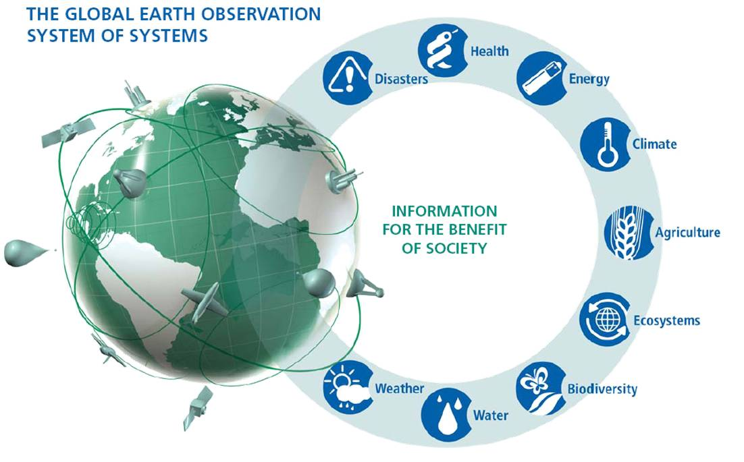
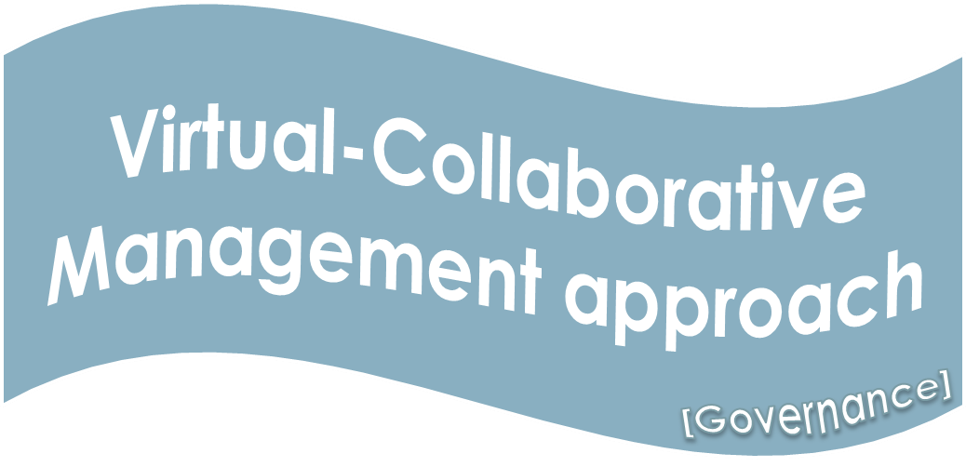
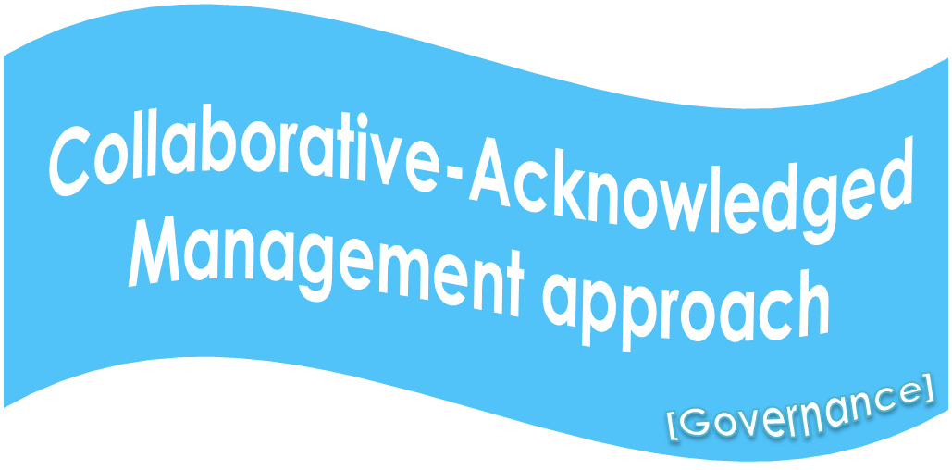
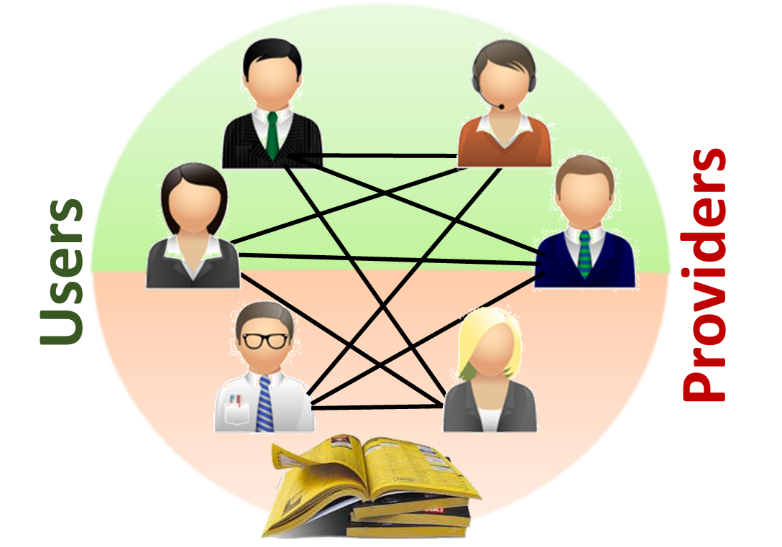
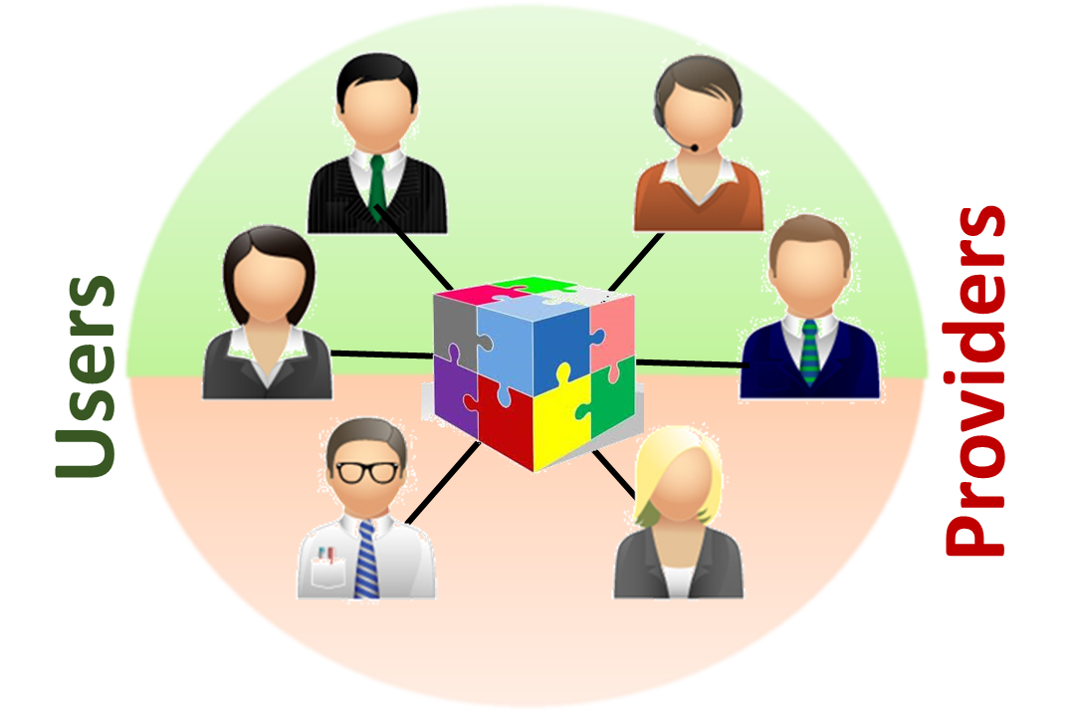
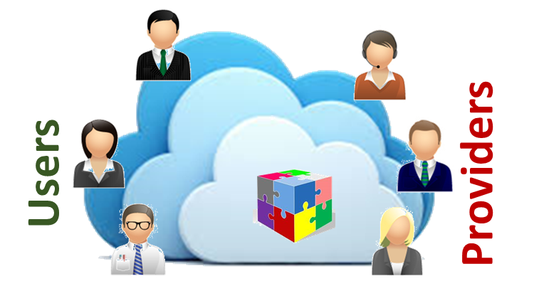
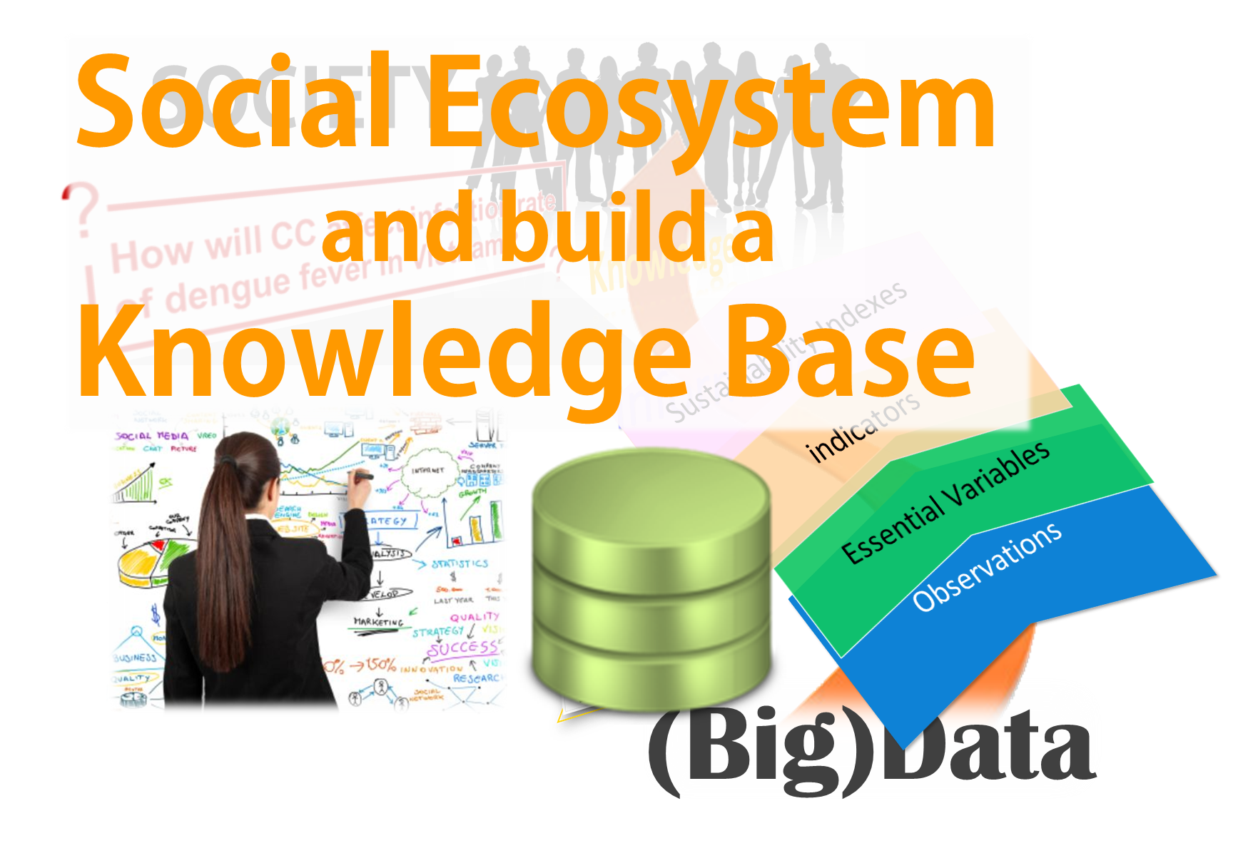
The Architectural Evolutions
2005
2011
2013
2016
1st Evolution
2nd Evolution
[Service driven]
Catalog of catalogs
3rd Evolution
[Brokering pattern]
Brokering framework
4th Evolution
[Big Data]
Cloud-based EcoSystem
[VRE]
… .
Discovery
Access
(re-)Use

Slide 19
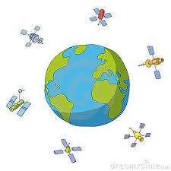





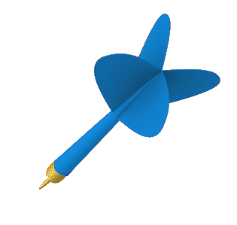
From Data to
Knowledge
Strategic Targets
Business Process
Business Process
Business Process
Observtn Data
Essential Variables
Indicators
Indexes
What if .. .
GEOSS Users

Slide 20



2005 GEOSS Implementation Plan Reference Document
Expert Knowledge
Models
Socio-economic Data
EO Data
Models
KNOWLEDGE
Socio-Economic Data
Earth Observation Data

Slide 21








What if…
Social Science
Socioeconomic
Fossil Fuel Use Model
[Source: GEO Sec]
Data
Climatology
Global Climate
Model
Regional
Climate Model
Observational Data
(environment &
vector distribution)
Data
Data
Data
Health
Deforestation/
Disturbance Model
Vector Niche
Model
Infection
Rate Model
Biodiversity
Data
Human Population Density
and Distribution Model
Infection Rates
Social Science

Slide 22





GEO Model Web
A dynamic web of models, integrated with databases and websites, to form a consultative infrastructure where researchers, managers, policy makers, and the general public can go to gain insight into “what if” questions
[Coordinators: Stefano Nativi (CNR) and Gary Geller (GEO sec)]

Slide 23


Software Ecosystem
2015
next decade
2025
Social Ecosystem

Slide 24










Data Volume
Users
EO Data Experts
(IT experts)
Environmental Experts
(Practitioners)
Global Change Experts
(Educators)
Policy Makers
(Citizens)
IT Experts
Non-IT Experts
Tomorrow
Re-use
Today
Inter
Interoperability Level
Access
Discover
Observations
Essential Variables
Indicators
(Sustainability) Indexes
Semantic content (From Data to Knowledge )
Notes:
Swimlane diagram

Slide 25
Thank you !
Questions?
http://www.sciencedirect.com/science/article/pii/S1364815215000481
Useful links
http://api.eurogeoss-broker.eu/docs/index.html
http://statistics.geodab.eu/gi-stat/stats

Slide 26



launched in response to calls for action by the 2002 World Summit on Sustainable Development, Earth Observation Summits, and by the G8 (Group of Eight) leading industrialized countries
voluntary partnership of 99 governments and 87 international organizations
provides a framework within which these partners can develop new projects and coordinate their strategies and investments
charged with developing GEOSS
Notes:
The 10-year Implementation Plan is the implicit convention that glues together all Members and POs.

